Slide 1
Tutorial 8 Designing a Web Site with Frames

Slide 2
Objectives
Explore the uses of frames in a Web site
Create a frameset consisting of rows and columns of frames
Display a document within a frame
Format the appearance of a frame

Slide 3
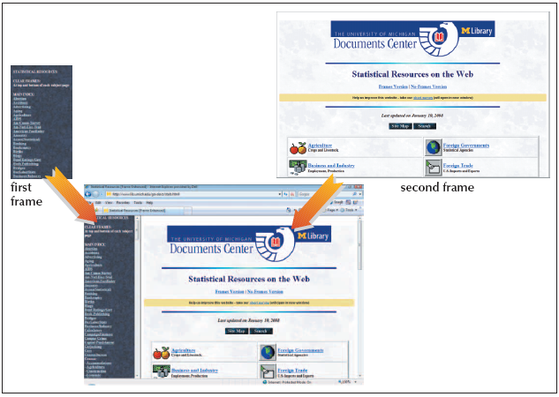
Introducing Frames
A frame is a section of the browser window capable of displaying the contents of an entire Web page

Slide 4
Disadvantages to Using Frames
The browser has to load multiple HTML files
Difficult to bookmark the Web site
Don’t work well with Internet search engines

Slide 5
Planning Your Frames
Before you start creating your frames, plan their appearance and how they are to be used:
What information will be displayed in each frame?
How do you want the frames placed on the Web page? What is the size of each frame?
Which frames will be static—that is, always showing the same content?
Which frames will change in response to links being clicked?
What Web pages will users first see when they access the site?
Should users be permitted to resize the frames to suit their needs?

Slide 6
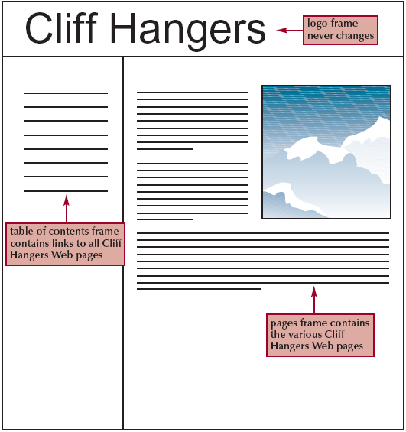
Planning Your Frames
Notes:
Notes:

Slide 7
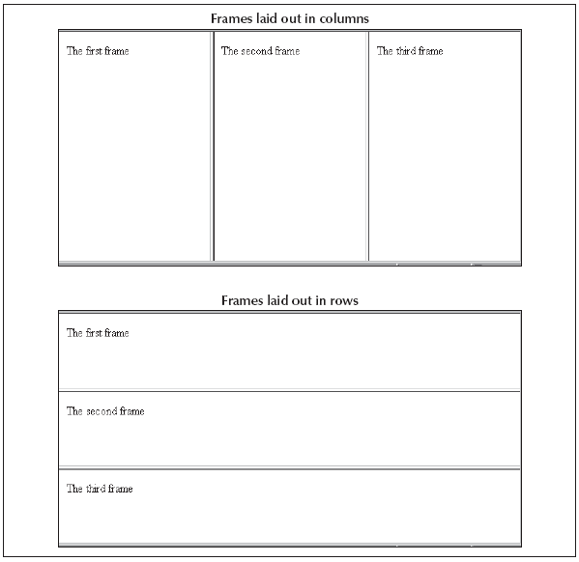
Frame Layout
You must choose to layout your frames in either rows or columns
A frameset describes the frame layout

Slide 8
Creating a Frameset
To create a frame layout, you will use the rows and cols attributes of the <frameset> element
The rows attribute creates a row of frames
The cols attribute creates a column of frames

Slide 9
The frameset Syntax
The syntax for creating a row frame layout is:
<frameset rows=“row1,row2, ...”> </frameset>
The syntax for creating a column frame layout is:
<frameset cols=“column1,column2,...”> </frameset>
where row and column specify the height (width) of a row (column) and can be specified as number of pixels, percentile of browser window dimensions, or the wild card (*)

Slide 10
Frameset: Important Note
The <frameset> code does not include an opening and closing <body> element
The reason for this is that this HTML file displays the contents of other Web pages; technically, it is not a Web page

Slide 11
Creating a Frameset
The <frameset> element is used to store the definitions of the various frames in the file.
These definitions will typically include:
Size and location of the frame
Web pages the frames display

Slide 12
Specifying a Frame Source
To specify a source for a frame, use the <frame> element with the syntax:
<frame src=“url” />
where url is the filename and location of the page that you want to load
You must insert the <frame> element between the opening and closing <frameset> elements

Slide 13
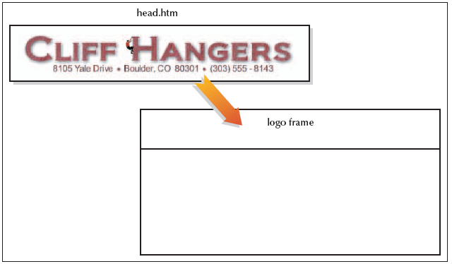
Logo and Placement
Notes:
Notes:

Slide 14
Nesting Framesets
To create frames using both rows and columns, one frameset must be nested inside another
The interpretation of the rows and cols attributes changes slightly
For example, a row height of 25% does not mean 25% of the display area, but rather 25% of the height of the frame into which that row has been inserted (or nested)

Slide 15
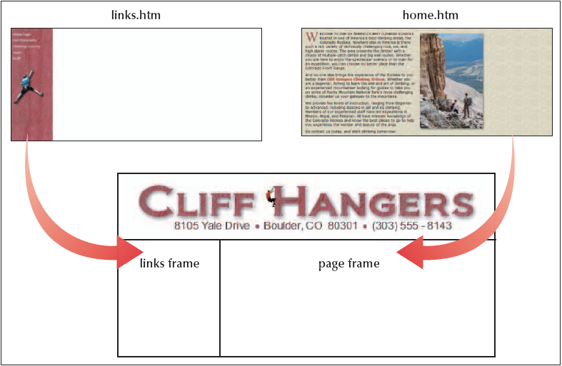
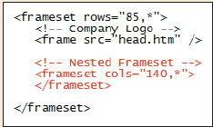
Creating a Nested Set of Frames
Notes:
Notes:
This example illustrates a common use of frames: displaying a table of contents in one frame, while showing individual pages from the site in another.

Slide 16

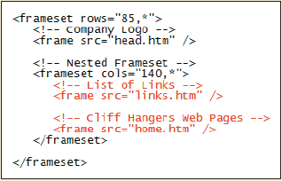
Inserting Frame Columns
Notes:
Notes:
This example illustrates a common use of frames: displaying a table of contents in one frame, while showing individual pages from the site in another.

Slide 17
Formatting a Frame
You can control three attributes of a frame:
Scroll bars
The size of the margin between the source document and the frame border
Whether or not the user is allowed to change the size of the frame

Slide 18
Hiding and Displaying Scroll Bars
By default, scroll bars are displayed when the content of the source page cannot fit within the frame
You can override the default setting using the scrolling attribute
The scrolling syntax is: scrolling=“type”
scrolling can either be “yes” (to always display scroll bars) or “no” (to never display scroll bars)

Slide 19
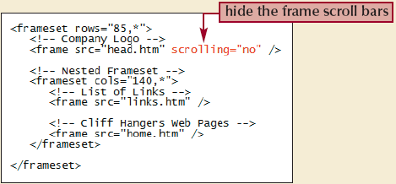
Removing the Scroll Bars
Notes:
Notes:
This example illustrates a common use of frames: displaying a table of contents in one frame, while showing individual pages from the site in another.

Slide 20
Setting Frame Margins
The following should be consider for frame margins:
The browser determines the amount of space between the content of the page and the frame border
Occasionally, the browser sets the margin between the border and the content too large
The margin should be big enough to keep the source’s text or images from running into the frame’s borders
The margin should not take up too much space, because you typically want to display as much of the source as possible

Slide 21
Specifying Margins Syntax
The syntax for specifying margins for a frame is:
marginheight=“value” marginwidth=“value”>
marginheight is the amount of space, in pixels, above and below the content of the page in the frame
marginwidth is the amount of space to the left and right of the page
If you specify only one, the browser assumes that you want to use the same value for both
Setting margin values is a process of trial and error as you determine what combination of margin sizes looks best

Slide 22
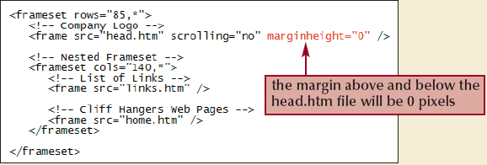

Specifying the Margin Sizes for the Frames
Notes:
Notes:
This example illustrates a common use of frames: displaying a table of contents in one frame, while showing individual pages from the site in another.

Slide 23
Controlling Frame Resizing
By default, users can resize frame borders in the browser by simply dragging a frame border
Some Web designers prefer to freeze, or lock, frames, so that users cannot resize them
This ensures that the Web site displays as the designer intended
The syntax for controlling frame resizing is: noresize=“noresize”
The noresize attribute is included within the <frame> element to prevent users from modifying the size of the frame

Slide 24
Session 8.1 - End

Slide 25
Objectives
Create links targeted at frames
Direct a link to a target outside of a frame layout
Format the color and size of frame borders
Create an inline frame

Slide 26
Working with Frames and Links
By default, clicking a link within a frame opens the linked file inside the same frame
You can display hyperlinks in many ways:
In a different frame
In a new window
In the entire window
When you want to control the behavior of links in a framed page, there are two required steps:
Give each frame on the page a name
Point each hyperlink to one of the named frames

Slide 27
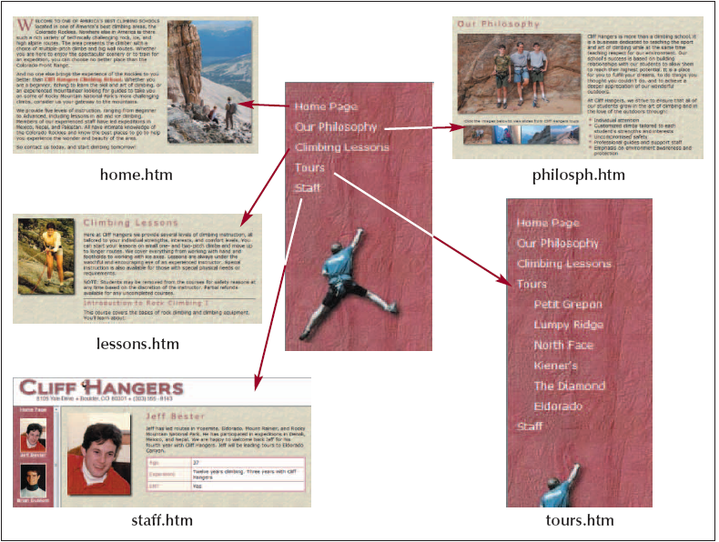
Working with Frames and Links
Notes:
Notes:
The table of contents page contains the following five hyperlinks:
The Home Page link points to home.htm
The Our Philosophy link points to philosph.htm
The Climbing Lessons link points to lessons.htm
The Tours link points to tours.htm
The Staff link points to staff.htm

Slide 28
Assigning a Name to a Frame
To assign a name to a frame, add the name attribute to the frame element
The syntax for this attribute is: <frame src=“url” name=“name” />
Case is important in assigning names: “information” is considered a different name than “INFORMATION”

Slide 29
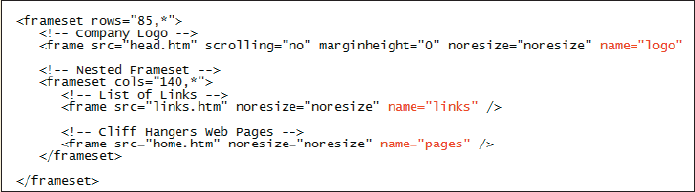
Setting the Frame Names
Notes:
Notes:
This example illustrates a common use of frames: displaying a table of contents in one frame, while showing individual pages from the site in another.

Slide 30
Specifying a Link Target
You can use the target attribute to open a page in a specific frame
The syntax for this is: target=“name”
When a page contains dozens of links that should all open in the same frame, HTML provides a way to specify a target frame for all the hyperlinks within a single page

Slide 31
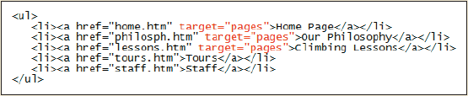
Specifying a Link Target
Notes:
Notes:
This example illustrates a common use of frames: displaying a table of contents in one frame, while showing individual pages from the site in another.

Slide 32
Using Reserved Target Names
Reserved target names are special names that can be used in place of a frame name as the target
They are useful in situations:
Where the name of the frame is unavailable
When you want the page to appear in a new window
When you want the page to replace the current browser window
All reserved target names begin with the underscore character ( _ ) to distinguish them from other target names
Reserved target names are case-sensitive, they must be entered in lowercase

Slide 33
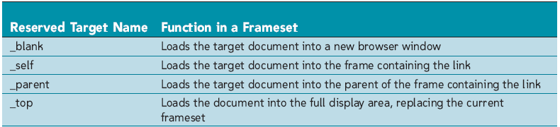
Using Reserved Target Names

Slide 34
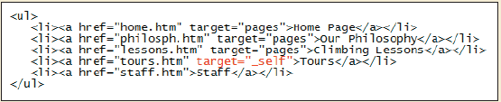
Using the _self Target

Slide 35
Using the <noframes> Element
Use the <noframes> element to allow your Web site to be viewable using browsers that do or do not support frames
When a browser that supports frames processes this code, it ignores everything within the <noframes> elements and concentrates solely on the code within the <frameset> elements
When a browser that doesn’t support frames processes this code, it doesn’t know what to do with the <frameset> and <noframes> elements, so it ignores them
When you use the <noframes> element, you must include <body> elements, this way, both types of browsers are supported within a single HTML file

Slide 36
The <noframes> Syntax
The syntax for the <noframes> element is:
<html>
<head>
<title>title</title>
</head>
<frameset>
frames
<noframes>
<body>
page content
</body>
</noframes>
</frameset>
</html>

Slide 37

Frameless Version of a Web Site

Slide 38
Working with Frame Borders
There are additional attributes you can apply to the <frame> element that allow you to change border size and appearance. For example:
You can remove borders from your frames to free more space for text and images
You can change the color of the frame border so that it matches or complements the color scheme for your Web site

Slide 39
Setting the Frame Border Color
To change the color of a frame’s border, use the bordercolor attribute
The attribute can be applied either to an entire set of frames, using the <frameset> element, or to individual frames, using the <frame> element
The syntax for this attribute is:
bordercolor=“color”>

Slide 40

Web Site with Brown Frame Border

Slide 41
Setting the Frame Border Width
Another way of modifying frame borders is to change their widths using the border attribute
The border attribute can be used only in the <frameset> element, and not in individual <frame> element
The syntax for the border attribute is: <frame frameborder=“value”>
value is the width of the frame borders in pixels

Slide 42

Removing the Frame Borders

Slide 43
Creating Inline Frames
Another way of using frames is to create a floating frame
An inline frame is displayed as a separate box or window within a Web page
The frame can be placed within a Web page in much the same way as an inline image

Slide 44
The Floating Frames Syntax
The syntax for a floating frame is: <iframe src=“url”> alternate content </iframe>
URL is the name and location of the file you want to display in the floating frame
The alternate content is the content you want displayed in the browser that don’t support inline frames

Slide 45
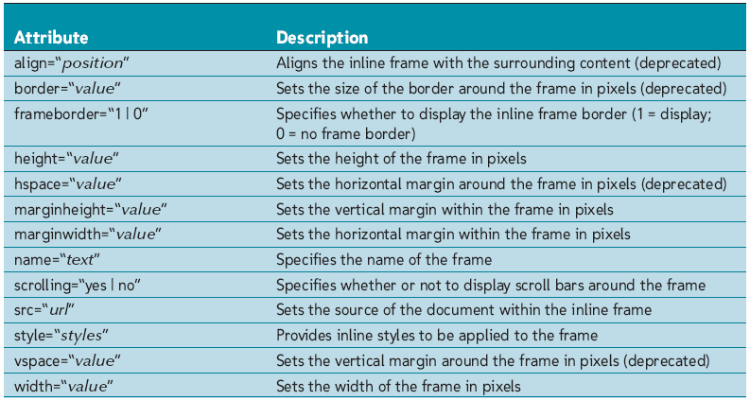
Attributes of inline Frames
Notes:
Notes:
This example illustrates a common use of frames: displaying a table of contents in one frame, while showing individual pages from the site in another.

Slide 46
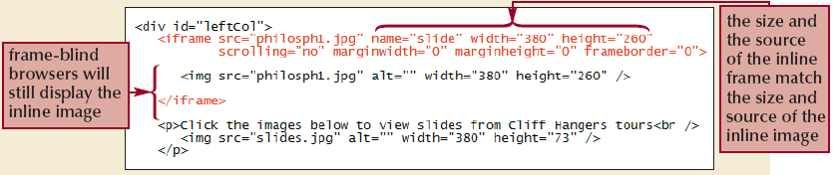
Creating an inline frame

Slide 47
Tutorial 8 - End

